Slide 1
WEEK 3
Python in Hacking

Slide 2
This week…
HTTP Requests and Responses
Reconnaissance on the web
Python Libraries to do this:
requests

Slide 3
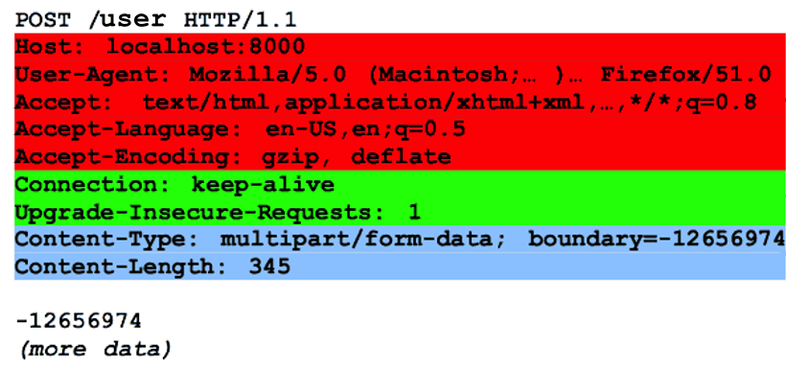
HTTP Request

Slide 4
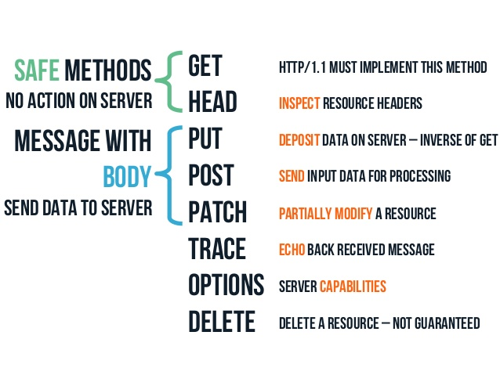
HTTP Methods

Slide 5
HTTP Request

Slide 6
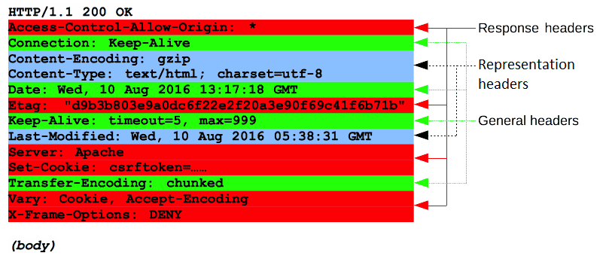
HTTP Response

Slide 7
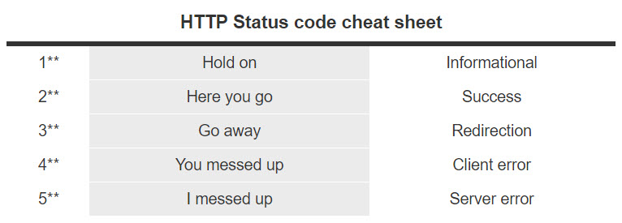
HTTP Status Codes

Slide 8
HTTP Response

Slide 9
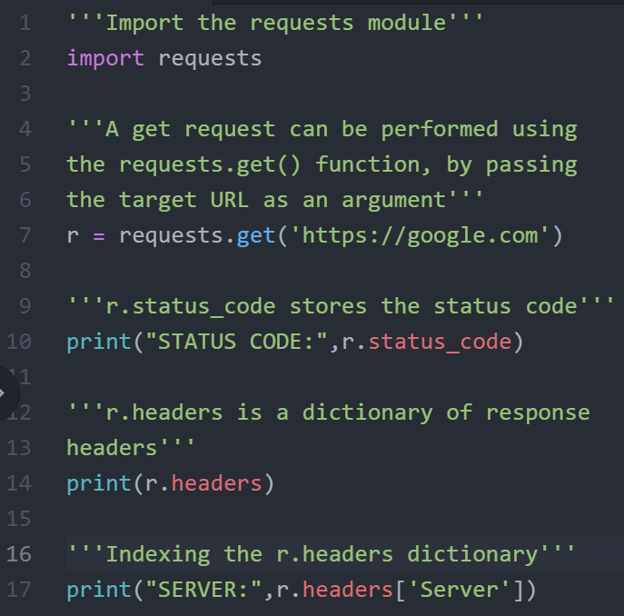
The requests Library

Slide 10
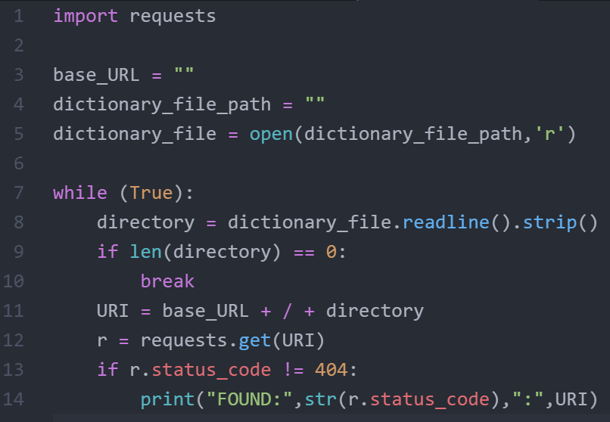
Directory Bruteforcer using requests

Slide 11
Thank You
Python in Hacking

